Slide 1
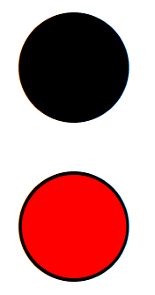
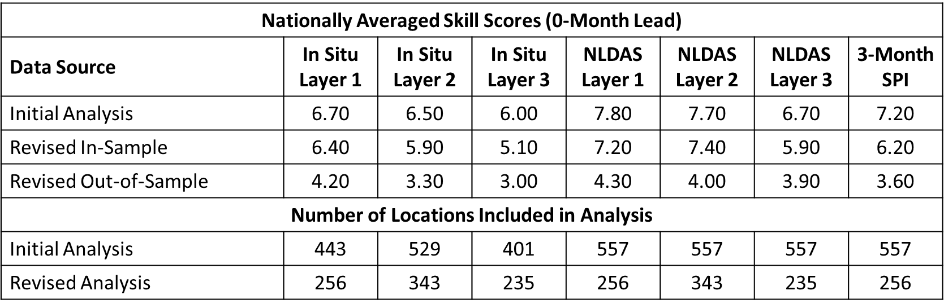
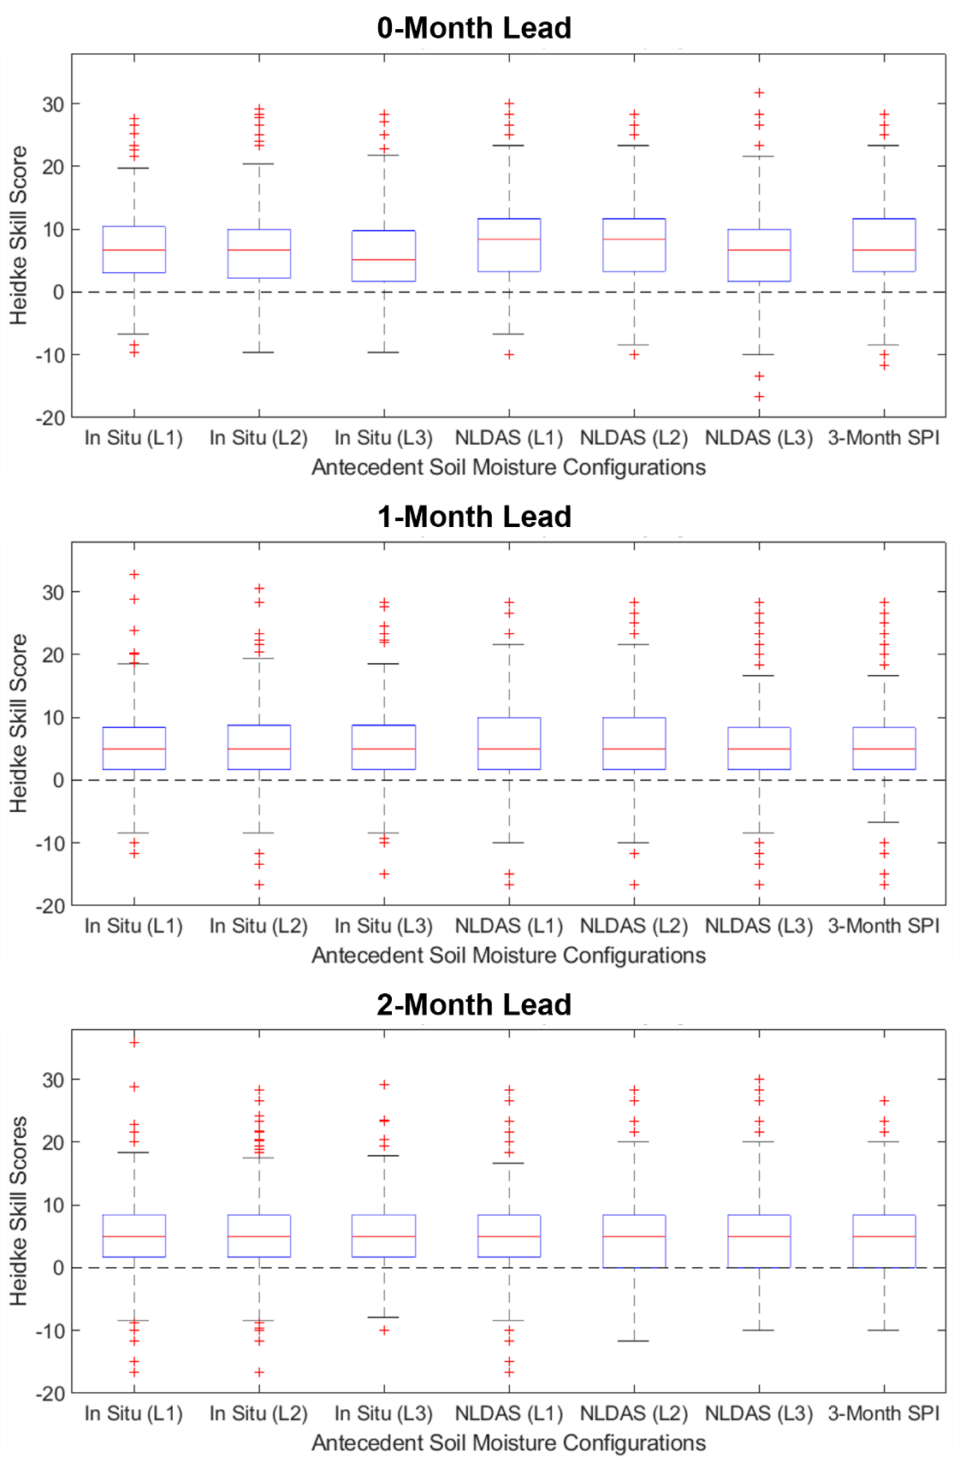
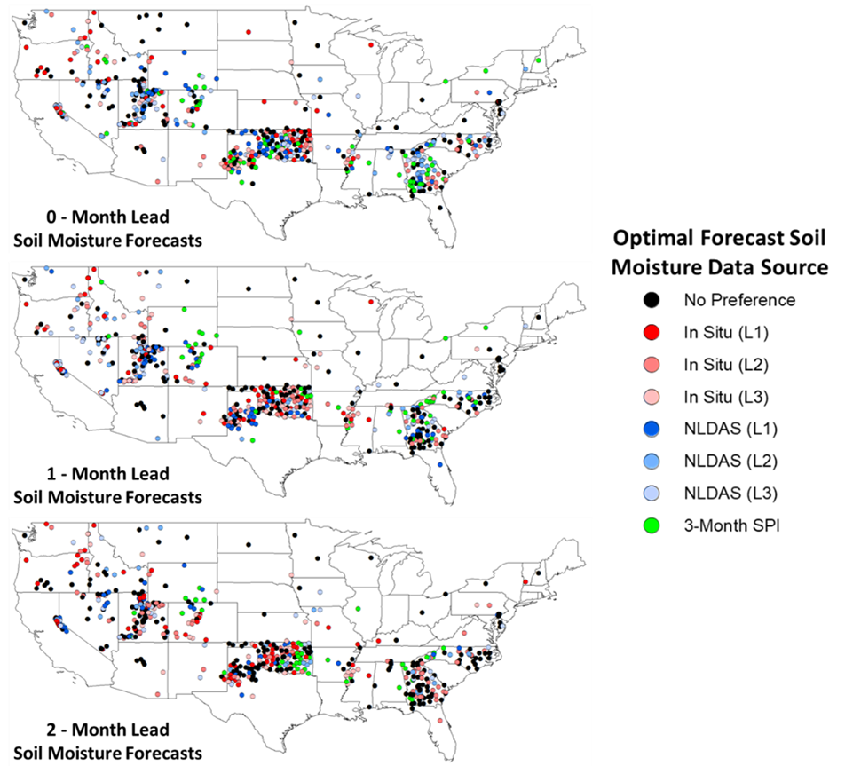
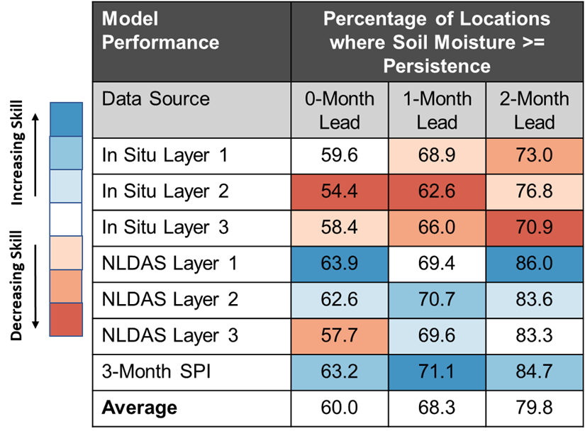
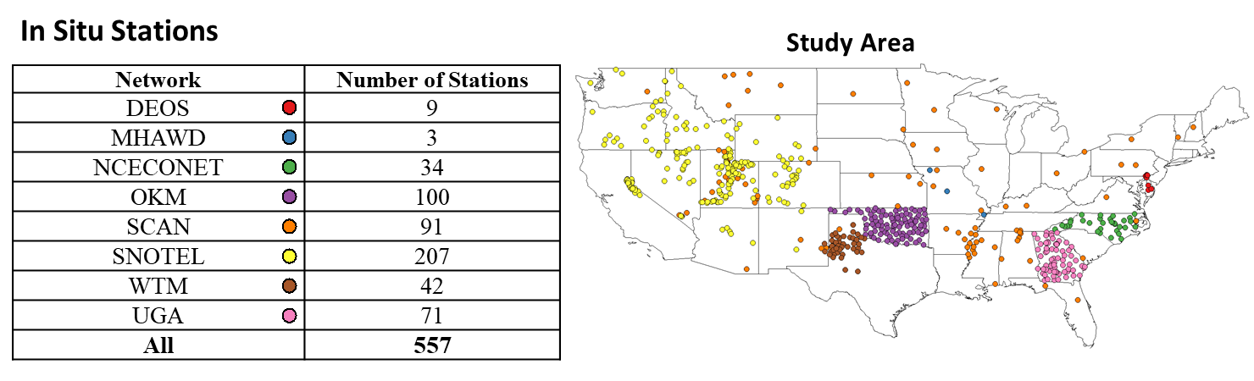
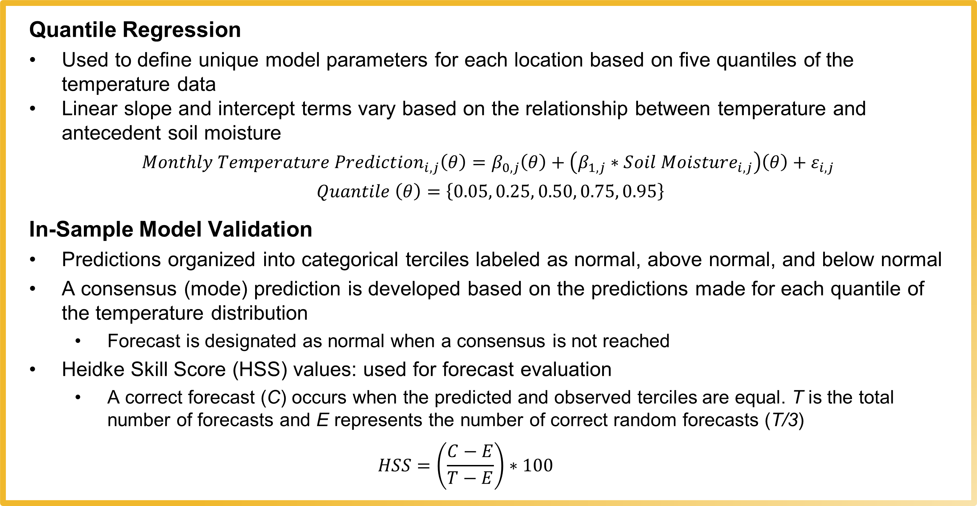
Utilizing Improved Model Validation Techniques to Reevaluate the Sensitivity of Monthly Temperature Predictions to Multiple Sources of Soil Moisture Data
Zack Leasor (leasorz@missouri.edu) , Steven Quiring (The Ohio State University), Chen Zhao (Verisk)
Motivation
Methods
Improved Model Validation Techniques
Soil moisture can improve temperature forecasts at subseasonal-to-seasonal (S2S) timescales, particularly during the warm season. This study builds upon previous work that integrated soil moisture data from direct in situ measurements, land surface models, and proxy estimates into statistical forecasts to examine how the source of data impacts model performance. A limitation of this method was that data sensitivity was only tested using in-sample model validation. Therefore, this study uses a more stringent selection of in situ soil moisture sites to conduct out-of-sample model validation and reevaluate the sensitivity of predictions to the soil moisture data source.
Quantile Regression
Used to define unique model parameters for each location based on five quantiles of the temperature data
Linear slope and intercept terms vary based on the relationship between temperature and antecedent soil moisture
$${Monthly Temperature Prediction}_{i,j}\left(θ\right)=β_{0,j}\left(θ\right)+\left(β_{1,j}∗S{oil Moisture}_{i,j}\right)\left(θ\right)+ε_{i,j}$$ $Quantile \left(θ\right)=\left\{0.05, 0.25, 0.50, 0.75, 0.95\right\}$
In-Sample Model Validation
Predictions organized into categorical terciles labeled as normal, above normal, and below normal
A consensus (mode) prediction is developed based on the predictions made for each quantile of the temperature distribution
Forecast is designated as normal when a consensus is not reached
Heidke Skill Score (HSS) values: used for forecast evaluation
A correct forecast (C) occurs when the predicted and observed terciles are equal. T is the total number of forecasts and E represents the number of correct random forecasts (T/3)
$$HSS=\left(\frac{C−E}{T−E}\right)∗100$$
Results from the initial analysis are based only on in-sample model validation with a tolerance for up to 20 months (33.3%) of missing monthly data
To reevaluate the sensitivy, a more stringent selection of stations (no missing data) is used, eliminating 153 locations from the initial analysis (Figure 3)
Rather than using an in-sample model validation, an out-of-sample cross validation is implemented by removing one year and holding out for model validation 10 times (folds)
The resultant skill scores are based only on the revised out-of-sample cross validation
Figure 3. Map displaying locations that are removed from analysis because there is missing data at all three depths (red). Locations that have at least one soil layer with a complete monthly in situ record (black) are used in the improved model validation techniques.
At least one layer with complete in situ record
No complete in situ records (removed from analysis)
Data
Monthly in situ soil moisture data (2009 – 2018) retrieved from eight networks (Figure 1)
Quality control used to identify stations continuously operating from 2009 to 2018
All measurements standardized as volumetric water content (VWC) percentiles
In situ data are compared with monthly soil moisture data from the North American Land Data Assimilation Phase-2 (NLDAS-2) Noah model
Soil layer 1 (0 - 10 cm), Soil layer 2 (10 - 40 cm), Soil layer 3 (40 - 100 cm)
In situ data are aggregated to NLDAS layers by averaging any measurements that fall within the range of depths
Monthly temperature and precipitation data from PRISM (http://prism.oregonstate.edu)
Precipitation data used to calculate the Standardized Precipitation Index (SPI)
Table 1. National distributions of HSS values for 0-month lead warm season maximum temperature forecasts made from 2009 – 2018. Results are compared between the initial analysis using all stations and the revised analysis with a more stringent selection of stations. Results are also compared based on skill scores using in-sample and out-of-sample model validation.
Results
Conclusions
Even with improved data quality and model validation techniques, preliminary results continue to show that in most cases the statistical forecast models are not sensitive to the type of soil moisture data used
Improving the quality of data and model validation techniques reduces the overall skill of soil moisture-based temperature forecasts
Future research will implement out-of-sample model validation techniques to test whether soil moisture-based forecasts are more skillful than persistence forecasts
a)
b)
c)
Figure 2. (a) National distributions (n = 557) of HSS value for 0-, 1-, and 2-month lead warm season maximum temperature forecasts made from 2009 – 2018. Forecasts were made at each station location with unique quantile regression models using different antecedent soil moisture configurations. (b) Maps displaying the data source and layer depth which promotes the highest forecast skill in warm season 0-, 1-, and 2-month lead quantile regression forecast models. Model performance is based on the calculation of HSS values from 2009 – 2018. (c) The percentage of locations where forecasts using varying soil moisture data sources have forecast skill greater than or equal to the skill of forecasts using temperature persistence. Forecast skill is based on HSS values calculated from warm season quantile regression models during 2009 – 2018.
Figure 1. Study area map displaying the locations and network providers for 557 in situ stations used in this analysis. All data were provided by The Ohio State University (http://www.nationalsoilmoisture.com) and the University of Georgia weather network (http://www.georgiaweather.net)

